Slide 1

Sujitkumar Hujare (24020448074)
Problem Statement
CO2 Emission Prediction for Vehicle
using Machine Learning
The Challenge:
Vehicle emissions contribute significantly to air pollution
Need accurate predictions for environmental compliance
Consumers need emission estimates before purchase
A Comparative Study of Regression Models for Vehicle Emission Forecasting
Use Case:
Predict CO2 emissions based on vehicle specifications
Help manufacturers optimize engine design
Support environmental policy decisions
Presented By : Sujitkumar Hujare PRN: 24020448074
Machine Learning
January 2026
Real-World Applications:
🚗 Automotive industry quality control
🌍 Environmental impact assessments
📊 Regulatory compliance reporting
💰 Carbon tax calculations

Slide 2

DATA OVERVIEW
Dataset Statistics:
Source: FuelConsumptionCo2.csv
Total Records: 1,067 vehicles (2014 models)
Data Quality: No missing values
Features: 13 attributes
Key Features Used:
Engine Size (1.0 - 8.4 liters)
Number of Cylinders (3 - 12)
Fuel Consumption (Combined city/highway)
Target: CO2 Emissions (108 - 488 g/km)
Data Characteristics:
Clean, pre-processed dataset
Strong correlation between features and target
Suitable for regression analysis
Problem Statement
The Challenge:
Vehicle emissions contribute significantly to air pollution
Need accurate predictions for environmental compliance
Consumers need emission estimates before purchase
Use Case:
Predict CO2 emissions based on vehicle specifications
Help manufacturers optimize engine design
Support environmental policy decisions
Real-World Applications:
🚗 Automotive industry quality control
🌍 Environmental impact assessments
📊 Regulatory compliance reporting
💰 Carbon tax calculations

Slide 3
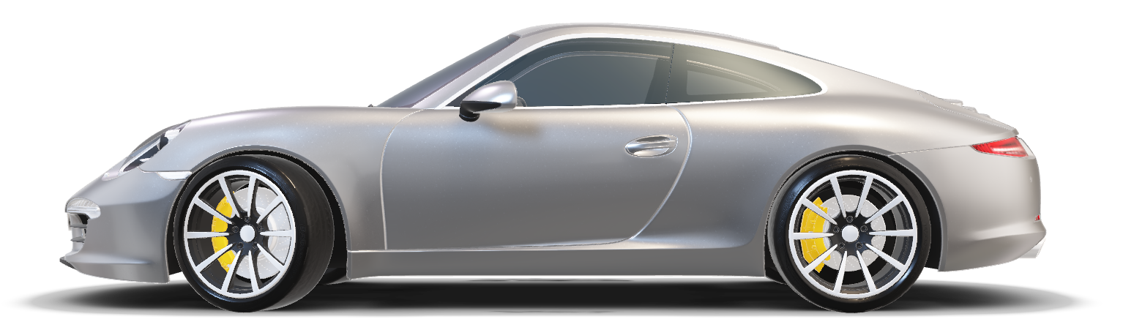
MODEL SELECTION APPROACH
DATA OVERVIEW
Methodology:
Data Loading & Exploration
Feature Selection
Train-Test Split (80/20)
Model Training (4 Algorithms)
Performance Evaluation
Model Comparison
Dataset Statistics:
Source: FuelConsumptionCo2.csv
Total Records: 1,067 vehicles (2014 models)
Data Quality: No missing values
Features: 13 attributes
Key Features Used:
Engine Size (1.0 - 8.4 liters)
Number of Cylinders (3 - 12)
Fuel Consumption (Combined city/highway)
Target: CO2 Emissions (108 - 488 g/km)
Data Characteristics:
Clean, pre-processed dataset
Strong correlation between features and target
Suitable for regression analysis
Evaluation Metrics:
R² Score - Variance explained (higher is better)
RMSE - Root Mean Squared Error (lower is better)
MAE - Mean Absolute Error (lower is better)
Models Evaluated:
Linear Regression
Decision Tree Regressor
Random Forest Regressor
Polynomial Regression (Degree 2)

Slide 4

MODEL SELECTION APPROACH
Methodology:
Data Loading & Exploration
Feature Selection
Train-Test Split (80/20)
Model Training (4 Algorithms)
Performance Evaluation
Model Comparison
Evaluation Metrics:
R² Score - Variance explained (higher is better)
RMSE - Root Mean Squared Error (lower is better)
MAE - Mean Absolute Error (lower is better)
Models Evaluated:
Linear Regression
Decision Tree Regressor
Random Forest Regressor
Polynomial Regression (Degree 2)
MODEL COMPARISON RESULTS
Key Findings:
Best Accuracy: Random Forest (R² = 0.8158)
Fastest: Linear Regression
Most Interpretable: Linear Regression
Selected: Linear Regression (Best Balance)
Model | R² Score | RMSE | MAE | Speed | Interpretability
Linear Regression | 0.7616 | 31.40 | 24.10 | ⚡ Very Fast | ⭐⭐⭐ High
Decision Tree | 0.8096 | 28.06 | 21.18 | ⚡ Fast | ⭐⭐ Medium
Random Forest | 0.8158 | 27.60 | 20.99 | 🐢 Medium | ⭐ Low
Polynomial (Deg 2) | 0.7676 | 31.00 | 23.92 | ⚡ Fast | ⭐⭐ Medium

Slide 5

MODEL COMPARISON RESULTS
Production Ready
Stable and reliable
Well-established method
Easy maintenance
Simplicity & Interpretability
Clear equation: CO2 = 38.99 × Engine Size + 126.29
Easy to explain to stakeholders
Operational Efficiency
Very fast training & prediction
Low resource requirements
No hyperparameter tuning needed
Key Findings:
Best Accuracy: Random Forest (R² = 0.8158)
Fastest: Linear Regression
Most Interpretable: Linear Regression
Selected: Linear Regression (Best Balance)
Model | R² Score | RMSE | MAE | Speed | Interpretability
Linear Regression | 0.7616 | 31.40 | 24.10 | ⚡ Very Fast | ⭐⭐⭐ High
Decision Tree | 0.8096 | 28.06 | 21.18 | ⚡ Fast | ⭐⭐ Medium
Random Forest | 0.8158 | 27.60 | 20.99 | 🐢 Medium | ⭐ Low
Polynomial (Deg 2) | 0.7676 | 31.00 | 23.92 | ⚡ Fast | ⭐⭐ Medium
Real-Time Capability
Instant predictions
Can run on any device
Strong Performance
R² = 0.7616 (76% variance )
Acceptable accuracy for production use

Slide 6
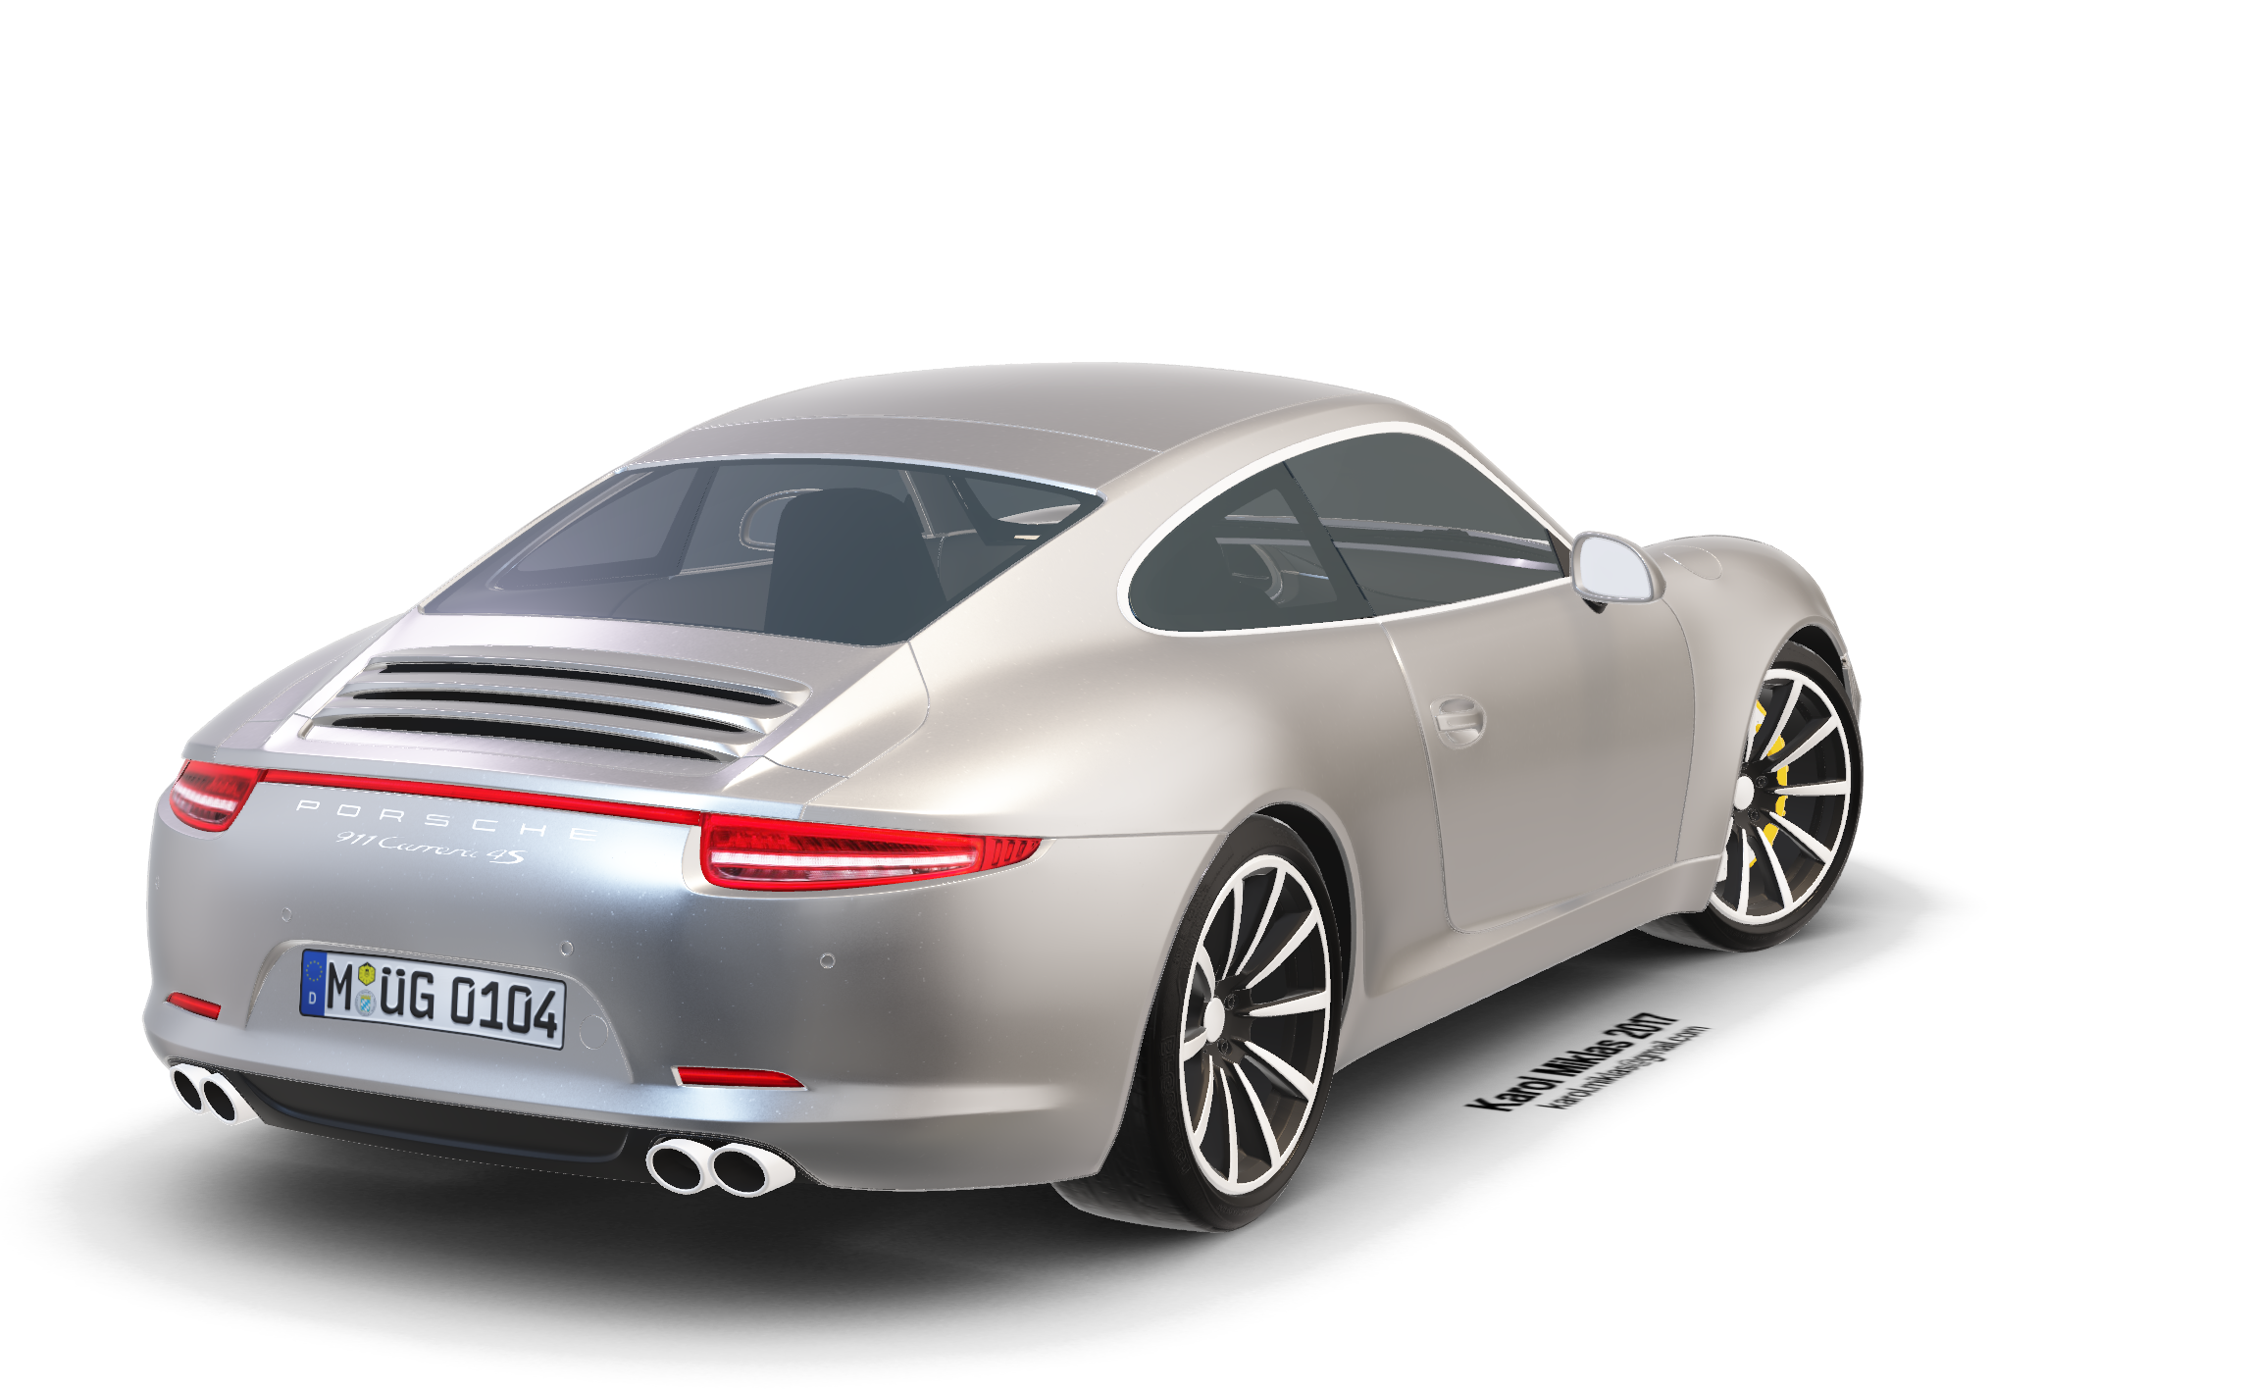
Random Forest Regressor (R² = 0.8158)
Pros: ✅ Highest accuracy | ✅ Robust | ✅ Reduces overfitting
Cons: ❌ Complex | ❌ Slower | ❌ Less interpretable
Use When: Maximum accuracy is critical (production systems)
MODEL SELECTION JUSTIFICATION
Polynomial Regression (R² = 0.7676)**
Pros: ✅ Captures non-linear patterns | ✅ Still interpretable
Cons: ❌ Risk of overfitting | ❌ Needs careful tuning
Use When: Clear non-linear relationships exist
Production Ready
Stable and reliable
Well-established method
Easy maintenance
Simplicity & Interpretability
Clear equation: CO2 = 38.99 × Engine Size + 126.29
Easy to explain to stakeholders
Operational Efficiency
Very fast training & prediction
Low resource requirements
No hyperparameter tuning needed
Real-Time Capability
Instant predictions
Can run on any device
Strong Performance
R² = 0.7616 (76% variance )
Acceptable accuracy for production use

Slide 7

ALTERNATIVE MODELS ANALYSIS
Results Summary:
Feature Performance:
Engine Size Model: R² = 0.7616
Fuel Consumption Model: R² = 0.8071** ⭐ Best
Sample Predictions:
Engine 2.0L → Predicted: 204 g/km CO2
Engine 5.0L → Predicted: 321 g/km CO2
Fuel 12.0L/100km → Predicted: 263 g/km CO2
Polynomial Regression (R² = 0.7676)**
Pros: ✅ Captures non-linear patterns | ✅ Still interpretable
Cons: ❌ Risk of overfitting | ❌ Needs careful tuning
Use When: Clear non-linear relationships exist
Random Forest Regressor (R² = 0.8158)
Pros: ✅ Highest accuracy | ✅ Robust | ✅ Reduces overfitting
Cons: ❌ Complex | ❌ Slower | ❌ Less interpretable
Use When: Maximum accuracy is critical (production systems)
System Architecture:
Data Input → Feature Selection → Train/Test Split
↓
Model Training (4 algorithms)
↓
Performance Evaluation
↓
Best Model Selection
↓
Model Deployment (.pkl files)

Slide 8

Model Optimization
Hyperparameter tuning (GridSearchCV)
Try advanced ensembles (XGBoost, Light GBM)
Implement cross-validation (K-fold)
Feature Engineering
Create interaction features (Engine × Cylinders)
Add polynomial features for non-linearity
Engineer ratio features (Power-to-Weight ratio)
TECHNICAL IMPLEMENTATION & RESULTS
Results Summary:
Feature Performance:
Engine Size Model: R² = 0.7616
Fuel Consumption Model: R² = 0.8071** ⭐ Best
Sample Predictions:
Engine 2.0L → Predicted: 204 g/km CO2
Engine 5.0L → Predicted: 321 g/km CO2
Fuel 12.0L/100km → Predicted: 263 g/km CO2
Data Enhancement
Collect recent vehicle data (2020-2025)
Include electric/hybrid vehicles
Add external factors (temperature, terrain)
System Architecture:
Data Input → Feature Selection → Train/Test Split
↓
Model Training (4 algorithms)
↓
Performance Evaluation
↓
Best Model Selection
↓
Model Deployment (.pkl files)
Performance Optimizatio
Apply feature scaling (StandardScaler)
Outlier detection and handling
Dimensionality reduction (PCA)
Deployment Strategy
Build REST API for real-time predictions
Implement model monitoring & retraining
Create mobile app interface

Slide 9
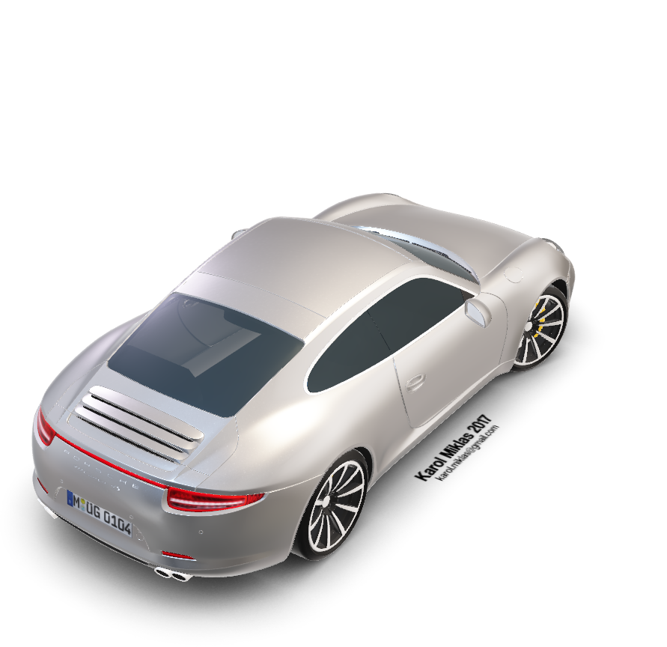
Key Findings:
Best Feature: Fuel Consumption (R² = 0.8071)
Best Model: Random Forest (R² = 0.8158)
Selected Model: Linear Regression (Best balance)
Insight: Simple models can be highly effective
RECOMMENDATIONS FOR IMPROVEMENT
Key Achievements:
Successfully predicted CO2 emissions with 76-81% accuracy
Evaluated 4 different ML algorithms
Delivered production-ready model
Created comprehensive comparison framework
Feature Engineering
Create interaction features (Engine × Cylinders)
Add polynomial features for non-linearity
Engineer ratio features (Power-to-Weight ratio)
Model Optimization
Hyperparameter tuning (Grid Search CV)
Try advanced ensembles (XG Boost, Light GBM)
Implement cross-validation (K-fold)
Data Enhancement
Collect recent vehicle data Include electric/hybrid vehicles
Add external factors (temperature, terrain)
Deployment Strategy
Build REST API for real-time predictions
Implement model monitoring & retraining
Create mobile app interface
Performance Optimization
Apply feature scaling (Standard Scaler)
Outlier detection and handling
Dimensionality reduction (PCA)
Impact:
Supports environmental compliance
Helps manufacturers optimize designs
Enables informed consumer decisions
Next Steps:
Deploy model as web service
Integrate with vehicle database
Implement real-time prediction system
Expand to include electric vehicles

Slide 10

CONCLUSION & NEXT STEPS
Key Achievements:
Successfully predicted CO2 emissions with 76-81% accuracy
Evaluated 4 different ML algorithms
Delivered production-ready model
Created comprehensive comparison framework
Key Findings:
Best Feature: Fuel Consumption (R² = 0.8071)
Best Model: Random Forest (R² = 0.8158)
Selected Model: Linear Regression (Best balance)
Insight: Simple models can be highly effective
Next Steps:
Deploy model as web service
Integrate with vehicle database
Implement real-time prediction system
Expand to include electric vehicles
Impact:
Supports environmental compliance
Helps manufacturers optimize designs
Enables informed consumer decisions
Thank You

Slide 11
Thank You

